Slide 1

A Socially Relevant Project -I presentation on Sentimental Analysis of Twitter Data
Presented by Batch No.: SRP-CSE-19-A-08
G. Naga Eshitha Roll No:19121A0565
C. Anusha Roll No:19121A0538
A. Abdul Bari Roll No:19121A0502
G. Hemanth Kumar Roll No:19121A0558
B. Nagendra Naik Roll No:19121A0524
Computer Science and Engineering
Under the guidance of
Dr.K.Reddy Madhavi
Associate Professor
Dept. of CSE
HOD:
Dr.B.Narendra Kumar Rao,
Professor & Head,
Dept. of CSE

Slide 2
Contents
Abstract
Introduction
Problem Statement
Objectives
System Requirements
Existing system
Software Requirements Specifications (SRS) Document Report Preparation
Proposed System
Algorithm
Design
Implementation
References
Conclusion
Queries

Slide 3
Abstract
Our day-to-day life has always been influenced by what people think. The term ‘social media’ includes twitter, Facebook, blogs, wikis and news, all typically yielding unstructured text and accessible through the web. The main purpose of sentiment analysis is to classify a user’s attitude towards various topics into positive, negative or neutral categories. Data such as web-postings, Tweets, videos, etc., all express opinions on various topics and events, offer immense opportunities to study and analyze human opinions and sentiment. Twitter Sentiment Analysis uses Natural Language Processing(NLP) and Aylien API for sentiment analysis automatic extraction or classification of sentiment from unstructured text. The result of the polarity of the text is displayed in the form of Pie-chart. Recent research indicates that emotion diffusion trends on Twitter are closely related to the sentiment polarities of Twitter tweets, we concentrate on how to combine textual knowledge from Twitter messages and sentiment diffusion trends to improve sentiment analysis output on Twitter details. To that end, we first investigate a process known as sentiment reversal and discover certain intriguing properties of sentiment reversals. The process of analyzing the differences of opinions and grouping them in all these categories is known as Sentimental Analysis.

Slide 4
Introduction
Sentiment analysis is a process of collecting and analyzing data based on the person’s feelings, reviews and thoughts. Sentiment analysis is a type of text research or opinion mining. Twitter is a micro-blogging platform where anyone can read or write short text messages called tweets.240 million active users,500 million tweets are generated every day. The amount of data accumulated on twitter is very huge and is in unstructured format. Twitter Sentiment Analysis is the process of accessing tweets on a particular topic and to predict the sentiment of these tweets as positive, negative or neutral with the help of machine learning algorithm. It applies a mix of statistics , natural language processing , and machine learning to identify and extract subjective information from text files, for instance , are viewer’s feelings, thoughts, judgments , or assessments about a particular topic, event , or a company and its activities as mentioned above. This analysis type is also known as opinion mining or affective rating. Sentimental Analysis is the most common text classification tool that analysis an incoming message and tells whether the underlying sentiment is positive , negative or neutral.

Slide 5
Problem Statement
With the rapid growth of the World Wide Web, people are using social media such as Twitter which generates big volumes of opinion texts in the form of tweets which is available for the sentiment analysis. This translates to a huge volume of information from a human viewpoint which make it difficult to extract a sentence, read them , analyze tweet by tweet, summarize them and organize them into an understandable format in a timely manner.

Slide 6
Objectives
To implement automatic classification of text into positive, negative and neutral and achieve 80% accuracy.
Sentiment Analysis is used for identifying the polarity of sentiments expressed by users.
AYLIEN Text Analysis API is a package of easy to use Natural Language Processing, Information Retrieval and Machine Learning tools that will help you extract meaning and insight from text.
The output is represented in the form of pie-chart which is given based on the polarity.

Slide 7
System Requirements
Hardware Requirements
Processor : i5
Hard disk : 500GB
Memory : 4GB RAM
Software Requirements
Operating System : Windows 10
Language : Python ,NLP
IDE : Python
Package : Tweepy , Matplotlib,
API : Twitter API, Aylien API

Slide 8
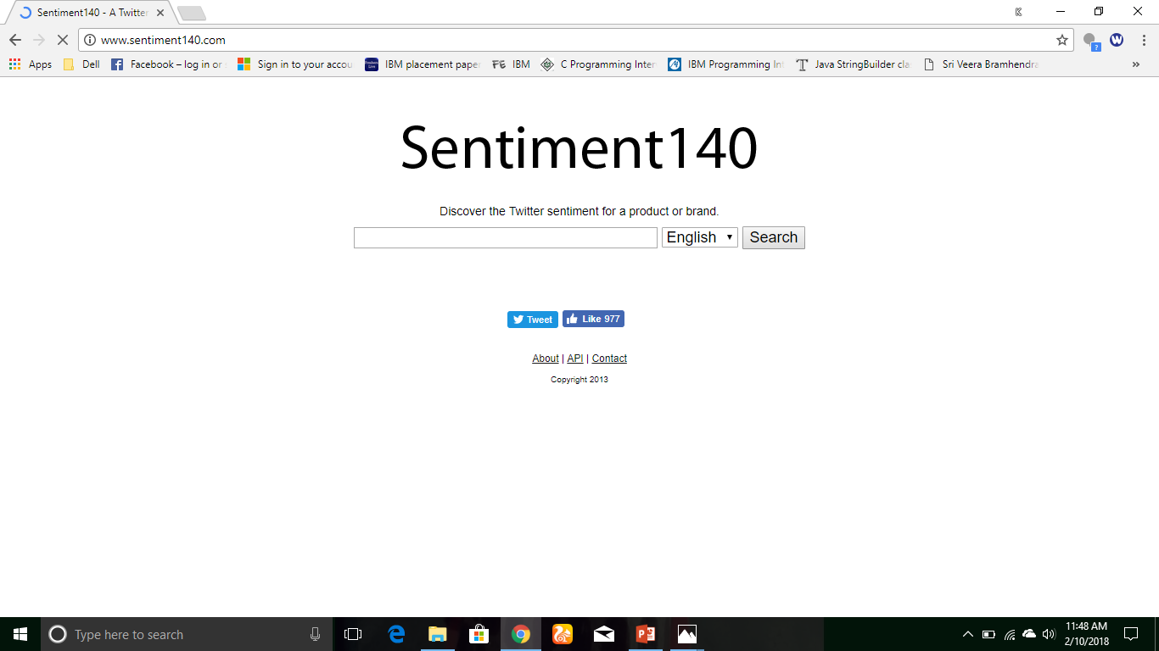
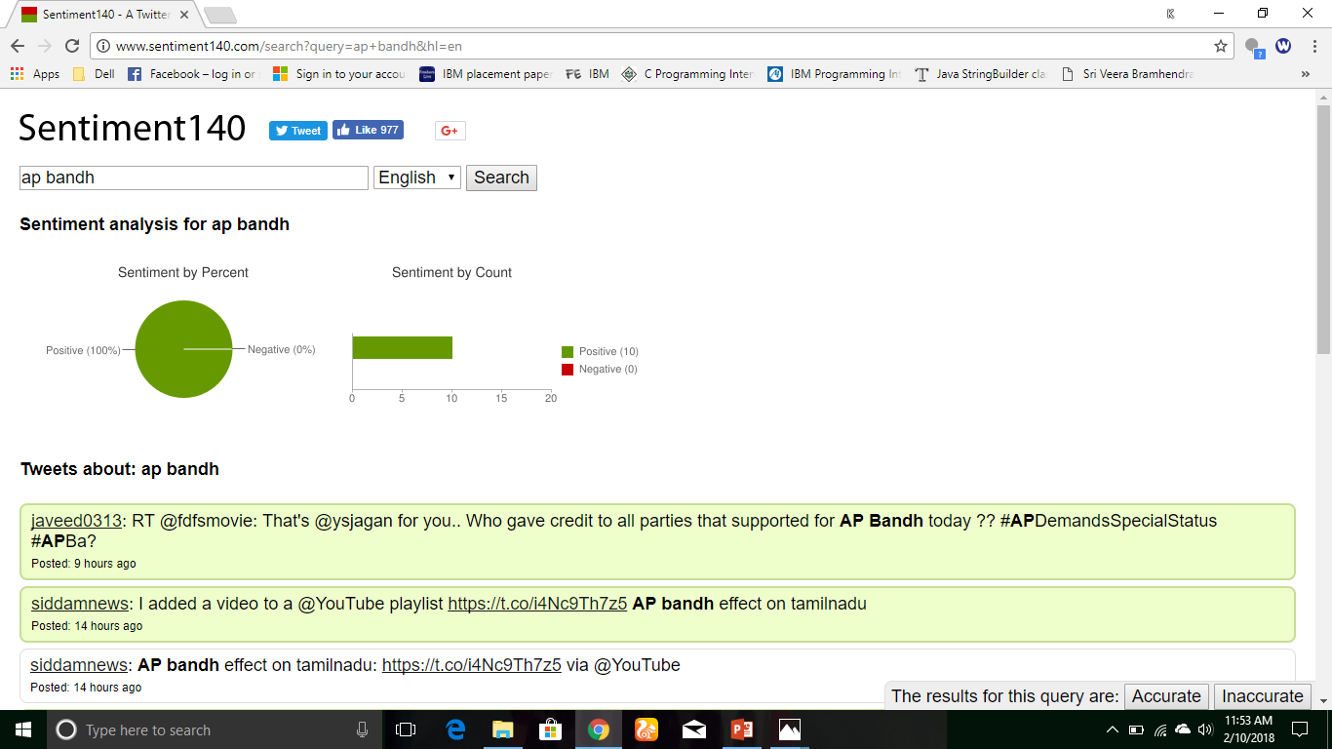
Existing System
Login with twitter account.
Entered key-word is “ap bandh”.
Result is displayed through pie-chart.

Slide 9
Software Requirements Specification
Functional Requirements:
Retrieving Input: The software will receive three inputs, keywords and no of Tweets.
● Keywords and no of tweets will be entered by the user.
● Tweets will be retrieved with the Twitter Streaming API.
Real-Time Processing : The software will take input, process data, and display output in real-time.
Sentiment Analysis : The sentiment analysis is performed on the user-specified keywords and determine the overall mood and provide a negative, neutral, or positive numeric sentiment value.
Output : The software may output real time data in the form of a graph of mood trends

Slide 10
Non Functional Requirements
Reliability: The software should meet all the requirements without any unexpected behaviour.
Availability: The software should be available all the times to the user, device in working order depend on internet access , If not the user should be alerted.
Security: The software should never collect personal information from its own twitter users.
Maintainability: The software should be written clearly, concisely and the code be well documented, Particular care be taken to design the software for easy maintenance.
Performance: The performance of the system is efficiency of integration of different components and detects system crashed, hanged and operating system errors.

Slide 11
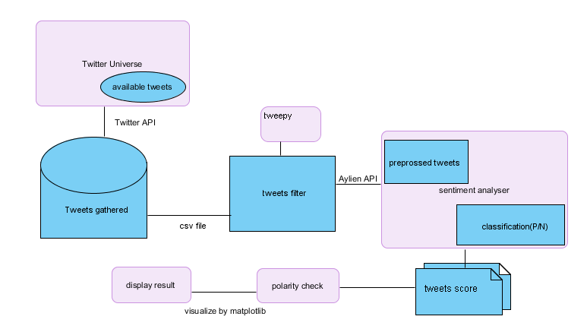
Proposed System

Slide 12
Approach Used
Tweet Downloader
Download the tweets using Twitter API
Tokenisation
Twitter specific POS Tagger developed by ARK Social Media Search
Pre-Processing
Removing non-English Tweets, URL, Target Mentions, Hashtags, Numbers, Nouns and Prepositions
Replacing Emoticons by their polarity
Replace Negative Mentions and Sequence of Repeated Characters
eg. ‘coooooooool’ by ‘cool’
Feature Extractor
Polarity Score of the Tweet
Number of Positive/Negative Capitalised Words and Hashtags
Number of Positive/Negative/Extremely Positive/Extremely Negative Emoticons
Number of special characters : ?,!,*
Classifier and Prediction Aylien Text API is used for analysis of the extracted feature or tweets

Slide 13
DESIGN
Usecase Diagram
Sequence Diagram

Slide 14
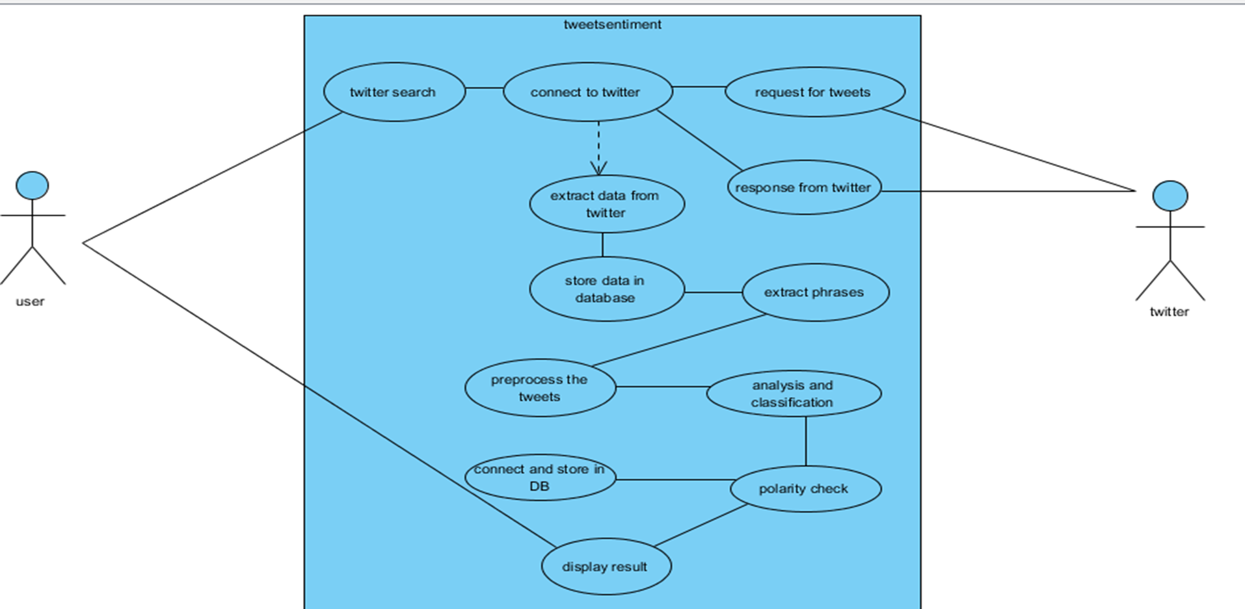
Use Case Diagram:

Slide 15
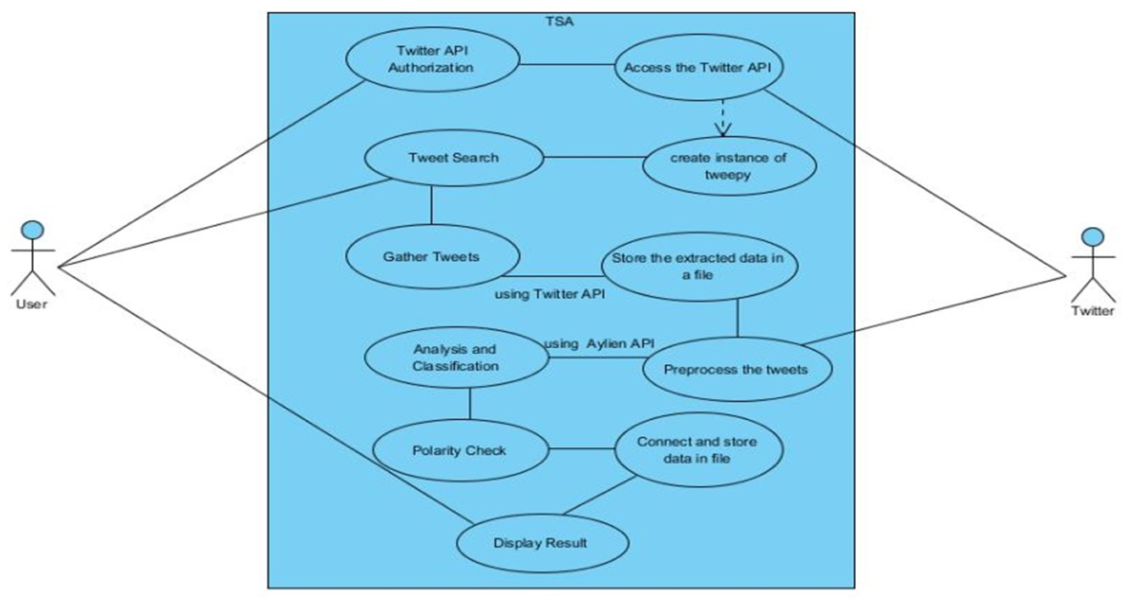
Usecase Diagram:

Slide 16
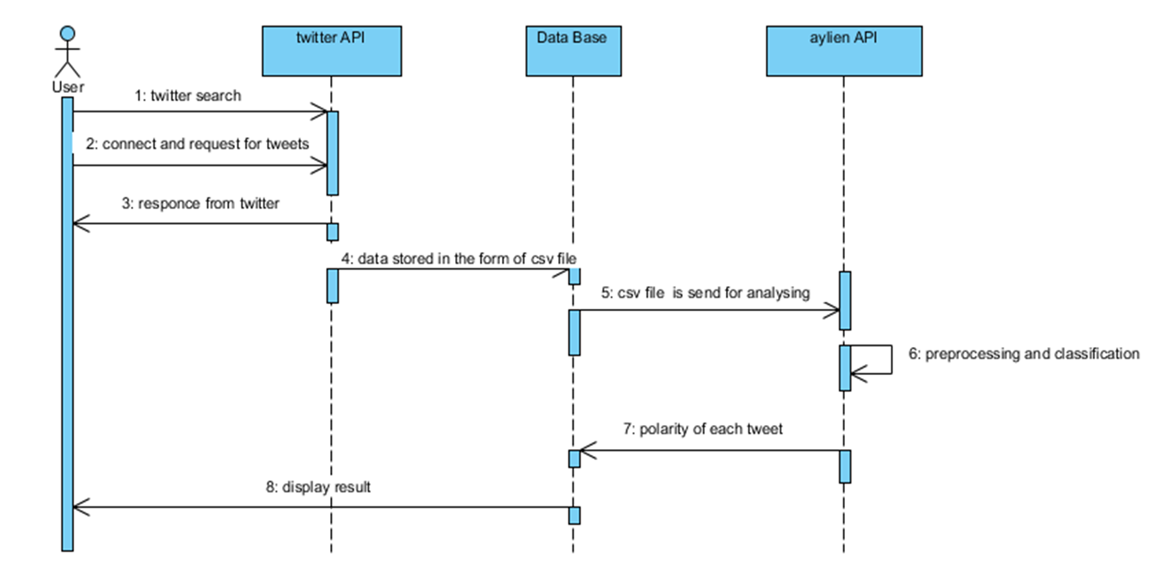
Sequence Diagram:

Slide 17
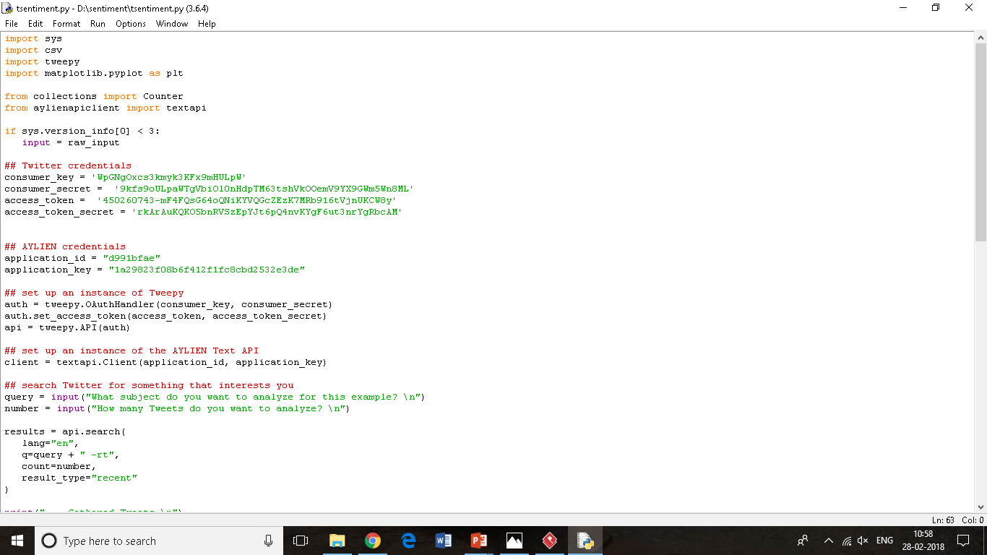
IMPLEMENTATION
Code for importing packages and authentication of API

Slide 18
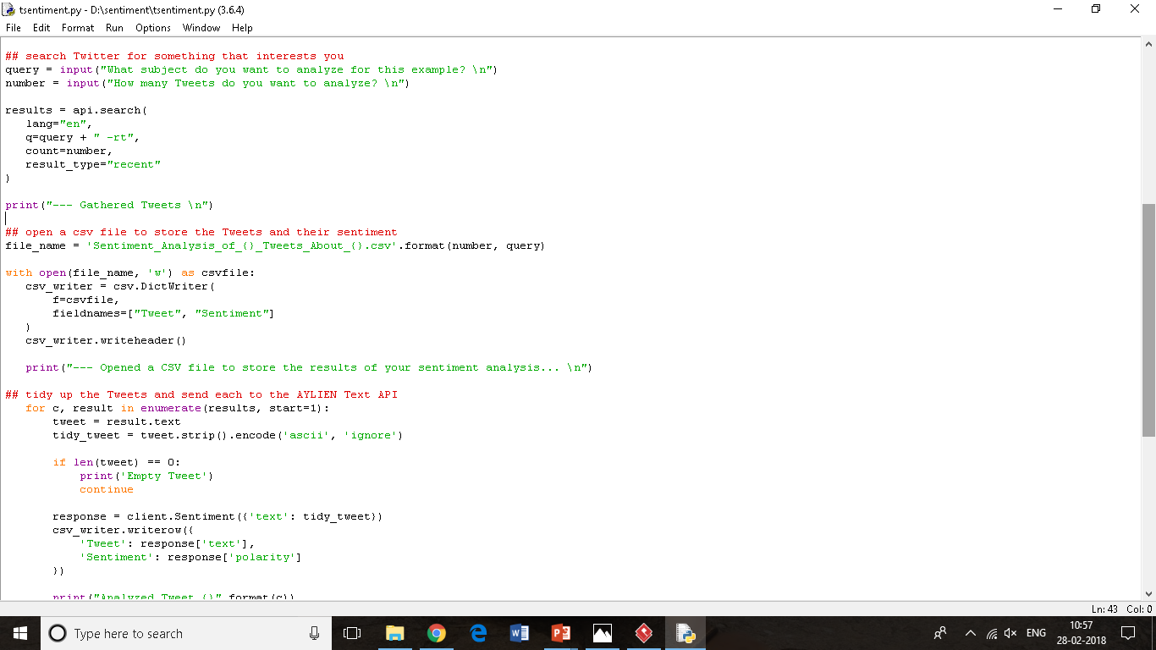
Code for data gathering

Slide 19
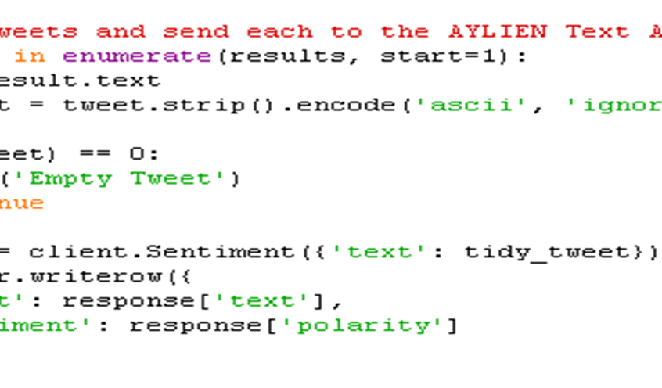
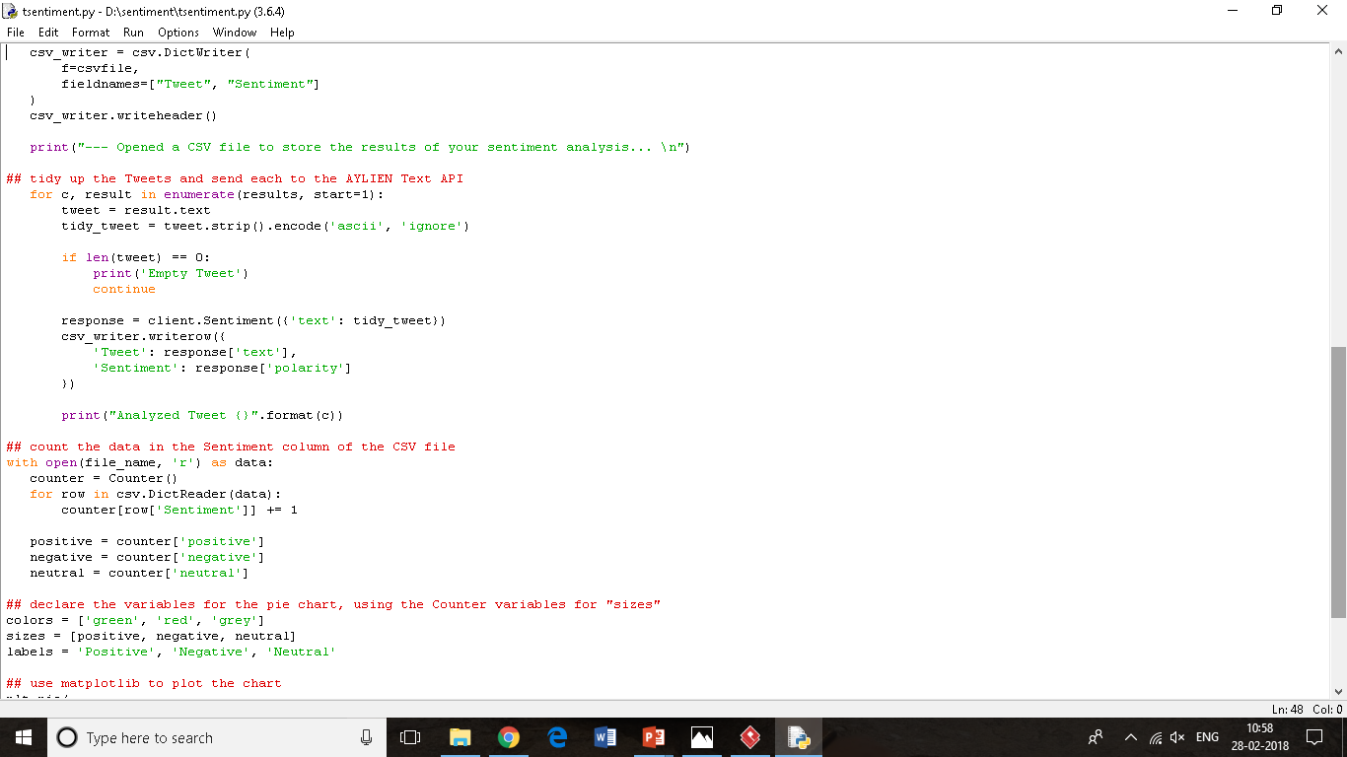
Code for cleaning text

Slide 20
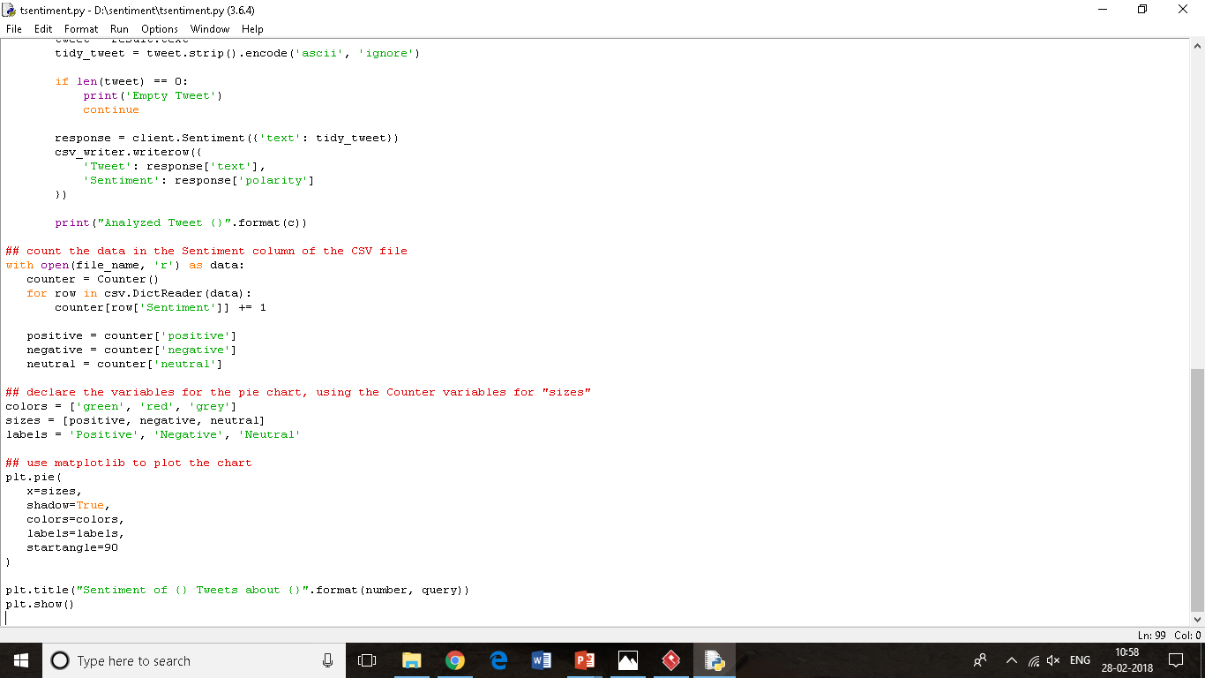
Code for analysing text and counting polarity

Slide 21
Code for visualization of output

Slide 22
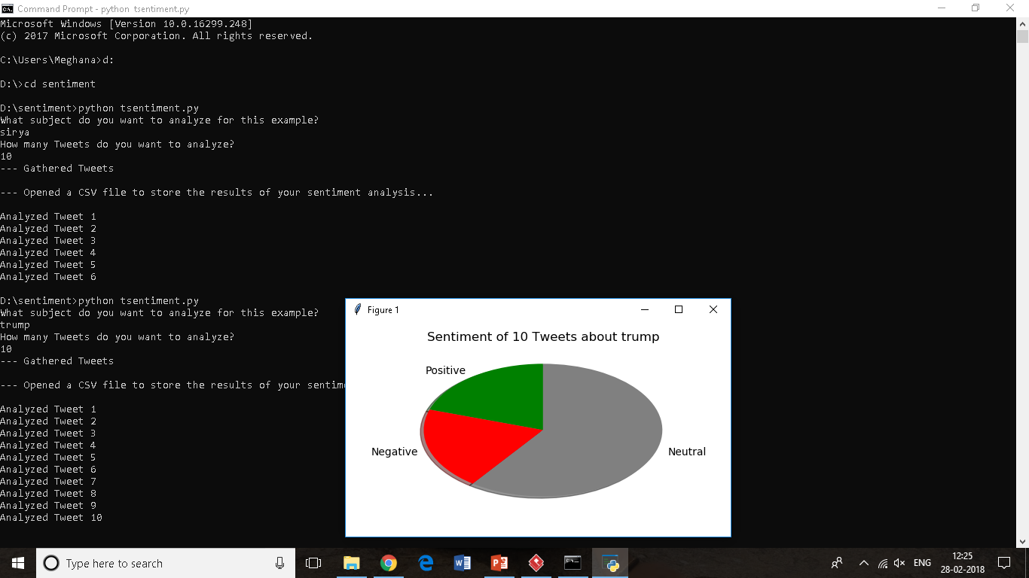
Code for visualization of output

Slide 23
References
A.Pakand P.Paroubek. „Twitter as a Corpus for Sentiment Analysis and Opinion Mining". In Proceedings of the Seventh
Conference on International Language Resources and Evaluation, 2010, pp.1320-1326
R. Parikh and M. Movassate , “Sentiment Analysis of User- Generated Twitter Updates using Various Classification
Techniques",CS224N Final Report, 2009
Go, R. Bhayani , L.Huang. “Twitter Sentiment Classification Using Distant Supervision". Stanford University, Technical Paper, 2009

Slide 24
CONCLUSION
Sentiment analysis is an evolving field with a variety of use applications. Although sentiment analysis tasks are challenging due to their natural language processing origins, much progress has been made over the last few years due to the high demand for it. Not only do companies want to know how their products and services are perceived by consumers (and compare to competitors), but consumers want to know the opinions of others before making buying decisions . The growing need for product insights – and the technical challenges currently facing the field –will keep sentiment analysis and opinion mining relevant for the foreseeable future. Next-generation opinion mining systems need a deeper bind between complete knowledge bases with reasoning methods inspired by human thought and psychology. This will lead to a better understanding of natural language opinions and will more efficiently bridge the gap between unstructured information in the form of human thoughts and structured data that can be analyzed and processed by a machine.Intelligent opinion mining systems capable of handling semantic knowledge, making analogies, continuous learning, and detecting emotions — leading to highly efficient sentiment analysis.

Slide 25
Queries

Slide 26
Thank You

